Slide 1
Sobel Edgeness
Heather Bradfield & Dylan Hart

Slide 2
Background
The Sobel filter is used in image processing and computer vision, particularly within edge detection algorithms where it creates an image emphasising edges.
It is named after Irwin Sobel.
A Sobel filter is calculated by turning the image into a field of vectors. These vectors represent the gradient of the image at each pixel calculated from a 3x3 neighborhood.
This is done by combining the results of two convolutions to calculate the approximate slopes of the X and Y directions.

Slide 3
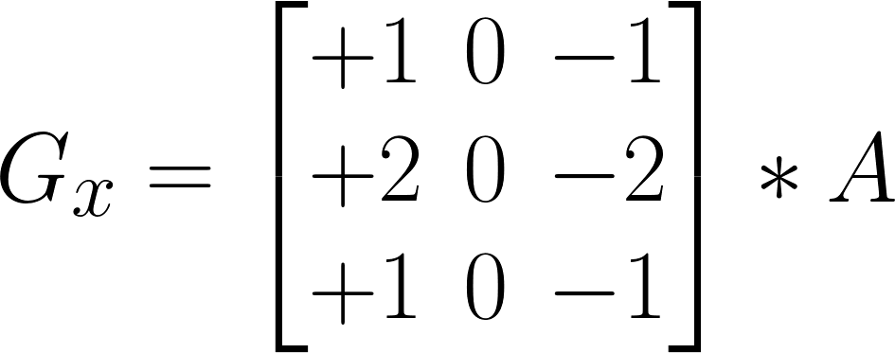
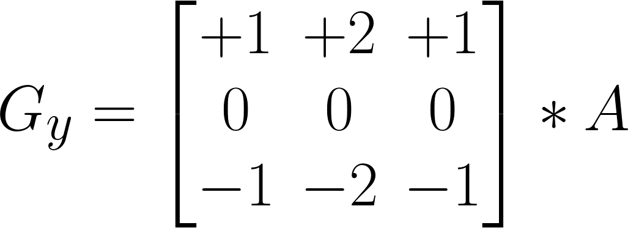
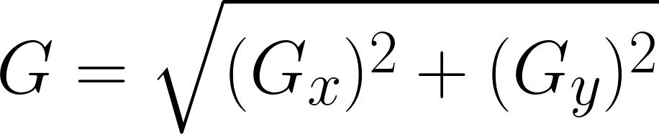
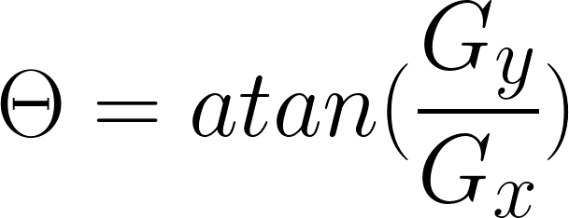
Method
Sobel Formulation:
Notes:
The operator uses two 3×3 kernels which are convolved with the original image to calculate approximations of the derivatives – one for horizontal changes, and one for vertical.
If we define A as the source image, and Gx and Gy are two images which at each point contain the horizontal and vertical derivative approximations
* here denotes the 2-dimensional signal processing convolution operation
At each point in the image, the resulting gradient approximations can be combined to give the gradient magnitude
We can also calculate the gradient's direction

Slide 4
Method
Threshold = mean value of the magnitudes of the edgeness for an image
Any point that has an above-average gradient magnitude will be counted as an edge.
Partition edges into N buckets based on their phase values
Bucket width = 2π / N
Bucket height = Sum of the magnitudes of all the edges in the bucket

Slide 5
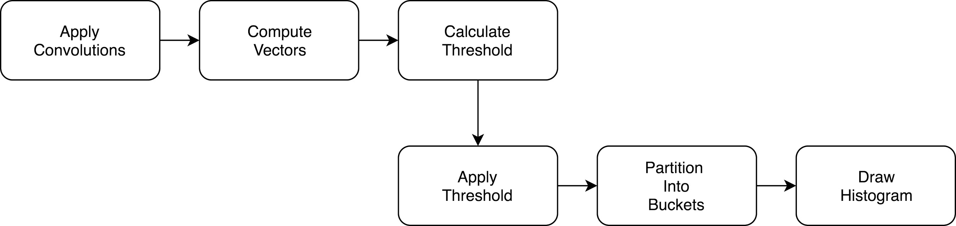
Method
SobelEdgeness Plugin

Slide 6
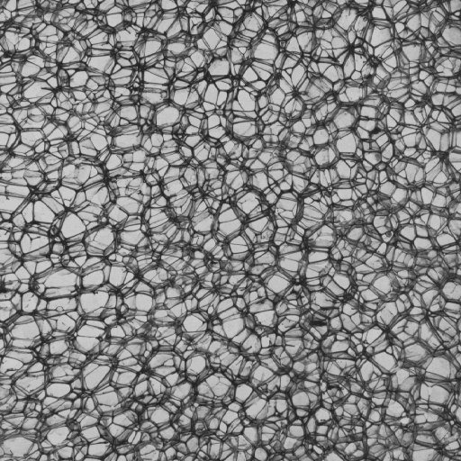
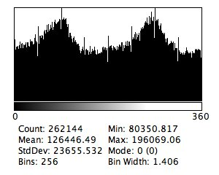
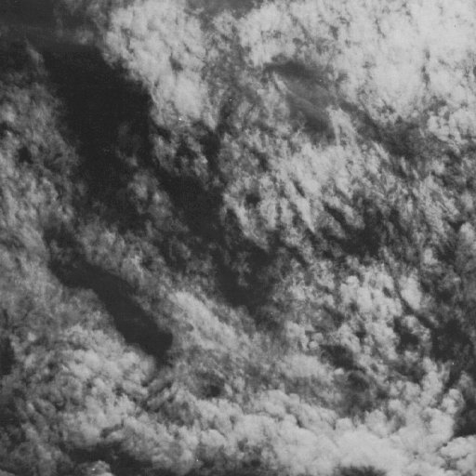
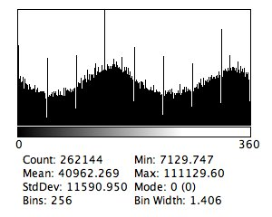
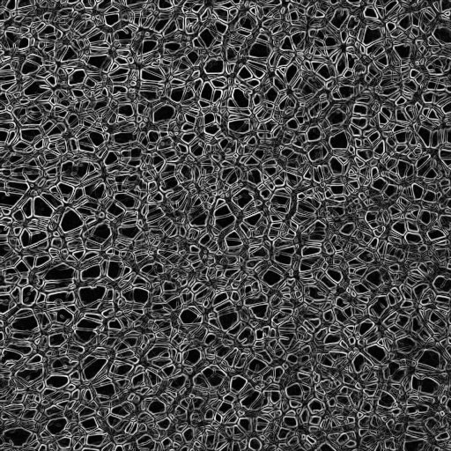
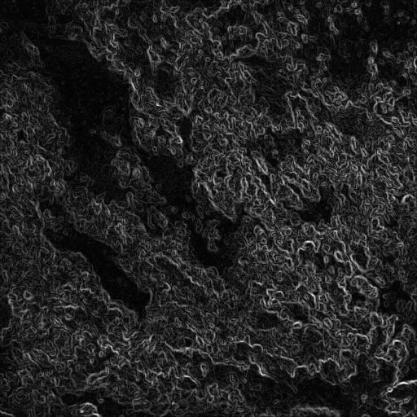
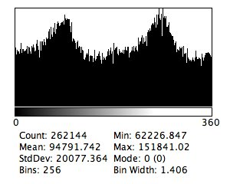
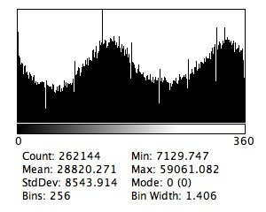
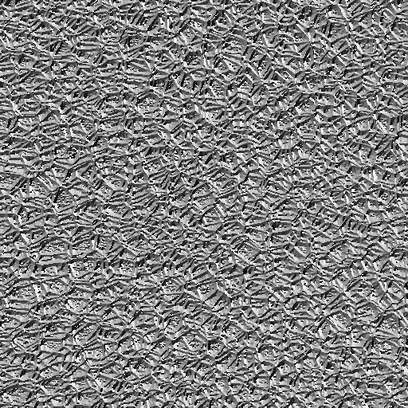
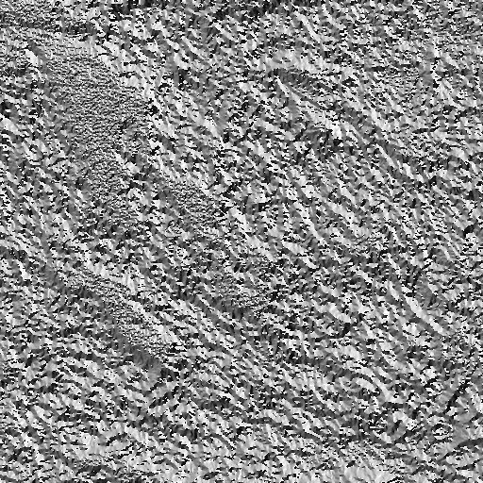
Results

Slide 7
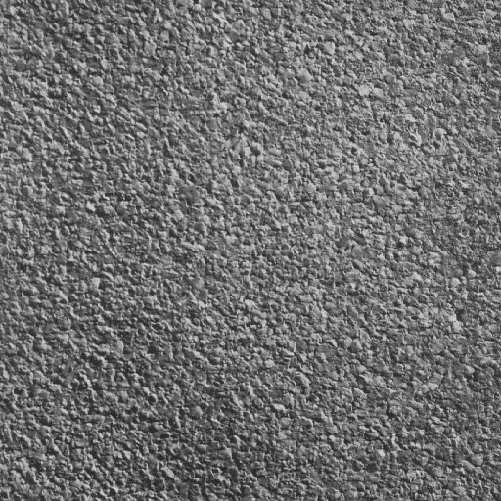
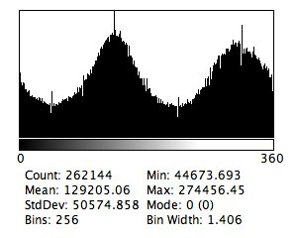
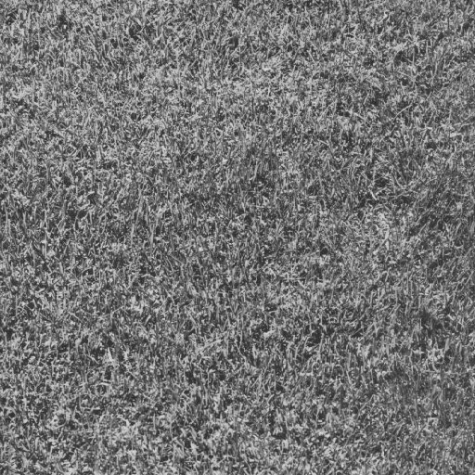
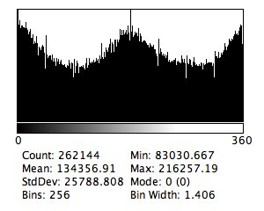
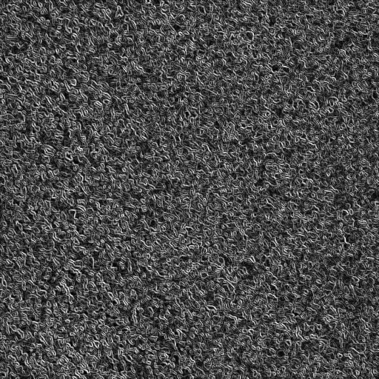
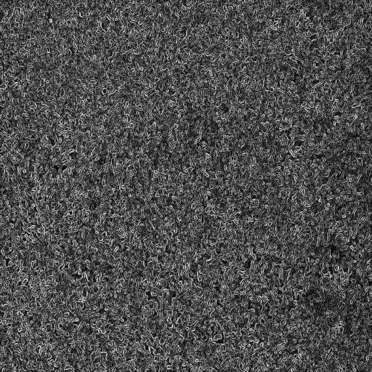
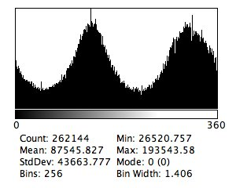
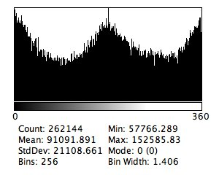
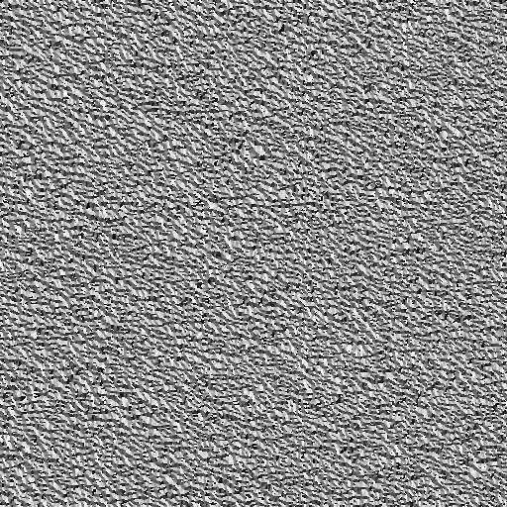
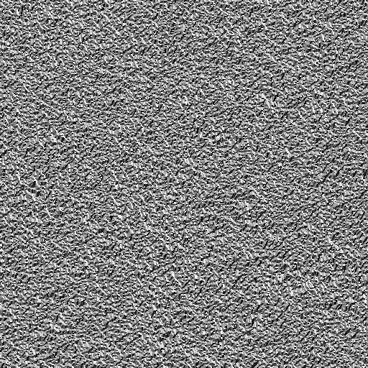
Results

Slide 8
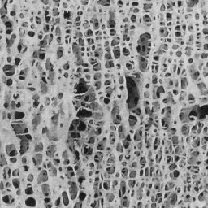
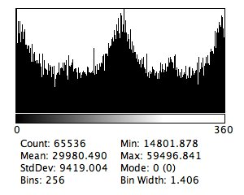

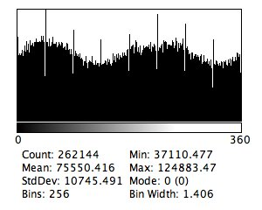
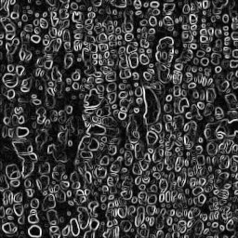
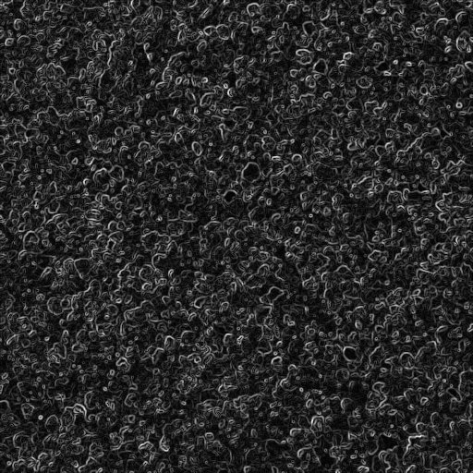
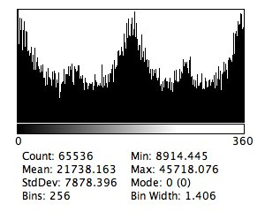
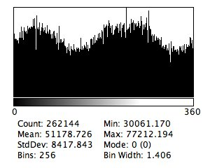
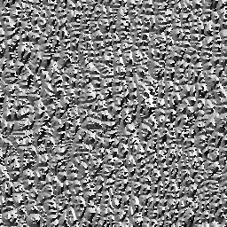
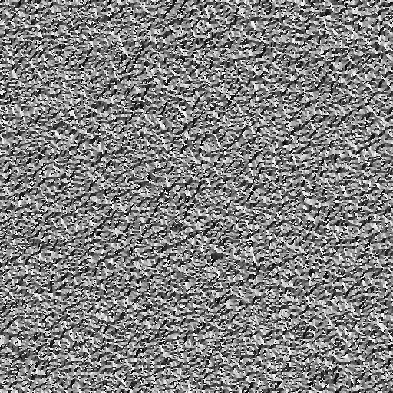
Results

Slide 9
Future Implementation
Custom Histogram class
Live updates - when the image changes, update the signature
Compare Images

Slide 10
References
Irwin Sobel, 2014, History and Definition of the Sobel Operator Geoff Dougherty, 2009, Digital Image Processing for Medical Applications

